Slide 1
Arduino Programming
Part-2

Slide 2
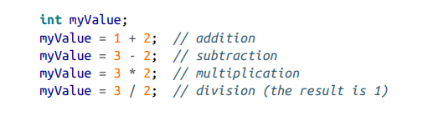

Adding, Subtracting, Multiplying, and Dividing
You want to perform simple math on values in your sketch.

Slide 3
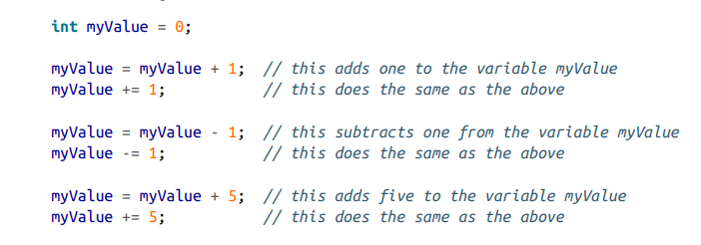
Incrementing and Decrementing Values
You want to increase or decrease the value of a variable.

Slide 4
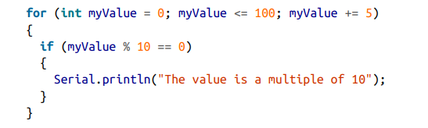
Finding the Remainder After Dividing Two Values
You want to find the remainder after you divide two integer values.

Slide 5
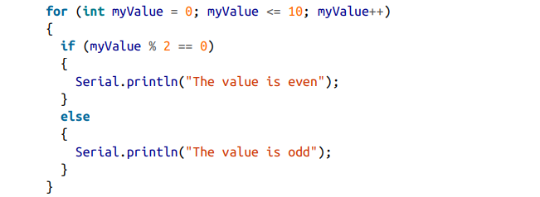
Finding the Remainder After Dividing Two Values
You want to find the remainder after you divide two integer values.

Slide 6
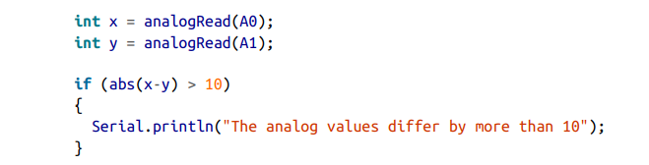
Determining the Absolute Value
You want to get the absolute value of a number.
abs(x) computes the absolute value of x.

Slide 7
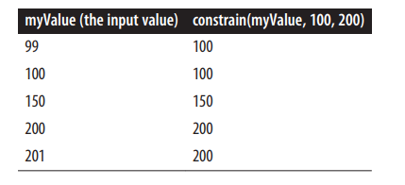
Constraining a Number to a Range of Values
You want to ensure that a value is always within some lower and upper limit.
constrain(x, min, max) returns a value that is within the bounds of min and max:
myConstrainedValue is set to a value that will always be greater than or equal to 100 and less than or equal to 200. If myValue is less than 100, the result will be 100; if it is more than 200, it will be set to 200.

Slide 8
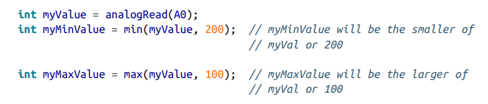
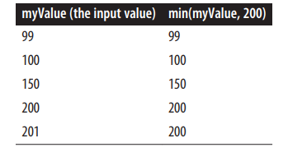
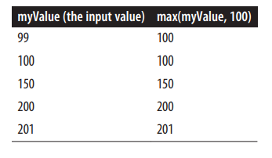
Finding the Minimum or Maximum of Some Values
You want to find the minimum or maximum of two or more values.
min(x,y) returns the smaller of two numbers. max(x,y) returns the larger of two numbers:

Slide 9
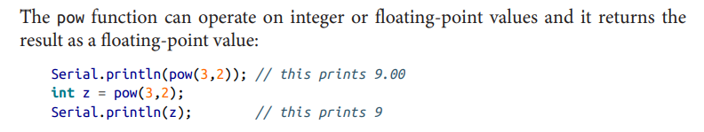
Raising a Number to a Power
You want to raise a number to a power.
pow(x, y) returns the value of x raised to the power of y:

Slide 10
Taking the Square Root
You want to calculate the square root of a number.
The sqrt(x) function returns the square root of x:

Slide 11
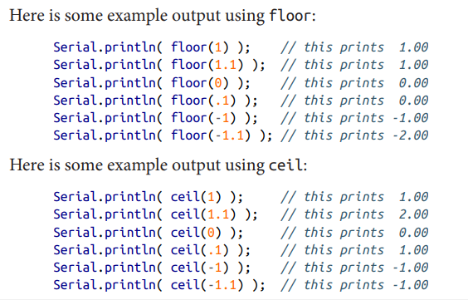
Rounding Floating-Point Numbers Up and Down
You want the next smallest or largest integer value of a floating-point number (floor or ceil).
floor(x) returns the largest integral value that is not greater than x. ceil(x) returns the smallest integer that is not less than x.

Slide 12
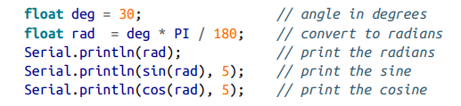
Using Trigonometric Functions
You want to get the sine, cosine, or tangent of an angle given in radians or degrees.
sin(x) returns the sine of angle x. cos(x) returns the cosine of angle x. tan(x) returns the tangent of angle x.

Slide 13

Generating Random Numbers
You want to get a random number, either ranging from zero up to a specified maximum or constrained between a minimum and maximum value you provide.
Use the random function to return a random number.

Slide 14
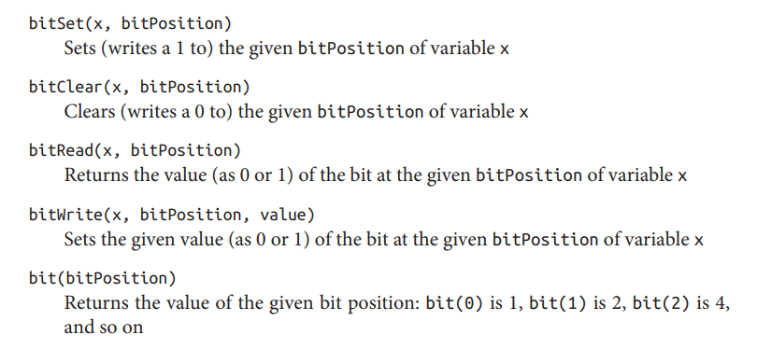
Setting and Reading Bits
You want to read or set a particular bit in a numeric variable.

Slide 15
Example:
void setup() {
Serial.begin(9600);
int x =4;
int n =1;
Serial.print(bitSet(x,n)); // print the output of bitSet(x,n)
}
void loop() { }
Output:
6

Slide 16
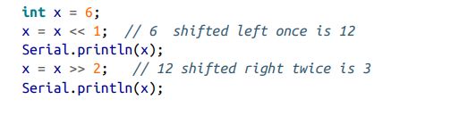
Shifting Bits
You need to perform bit operations that shift bits left or right in a byte, int, or long.
Use the << (bit-shift left) and >> (bit-shift right) operators to shift the bits of a value.

Slide 17
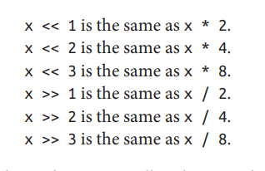

Slide 18
Extracting High and Low Bytes in an int or long
You want to extract the high byte or low byte of an integer; for example, when sending integer values as bytes on a serial or other communication line.
Use lowByte(i) to get the least significant byte from an integer. Use highByte(i) to get the most significant byte from an integer

Slide 19
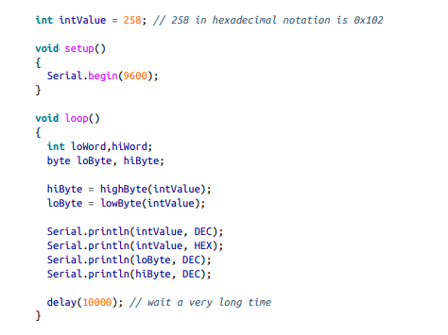
Extracting High and Low Bytes in an int or long

Slide 20

Extracting High and Low Bytes in an int or long

Slide 21


8 bit = 1 Byte = 2 hexadecimal digit
-------------------------------------------------------------
16 bit = 2 Byte = 1 word = 4 hexadecimal digit
=(1020304)_{h}
=(0304)_{h}=(772)_{d}
=(102)_{h}=(258)_{d}
HEX=1020304 => lowByte=(04)_{h}=(4)_{d}, highByte=03=(3)_{d}
lowWord=0304=(772)_{d}, highWord=0102=(258)_{d}
[there is no built in function such as lowWord or, highWord]

Slide 22
Forming an int or long from High and Low Bytes
You want to create a 16-bit (int) or 32-bit (long) integer value from individual bytes; for example, when receiving integers as individual bytes over a serial communication link.
Use the word(h,l) function to convert two bytes into a single Arduino integer

Slide 23

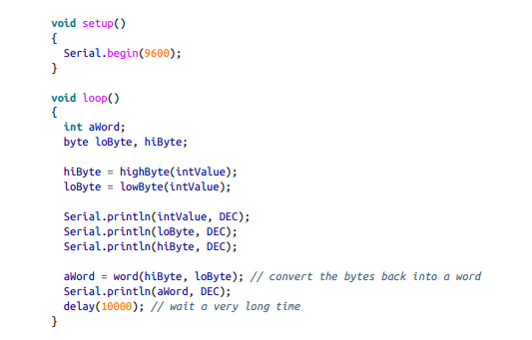

Slide 24
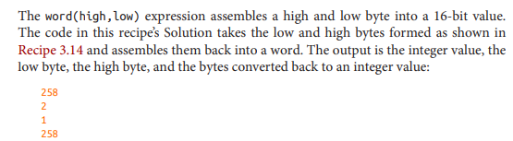
HEX=0102=> lowByte=(02)_{h}=(2)_{d}, highByte=01=(1)_{d}
word(02,01) = 0201 = (258)_{d}

Slide 25
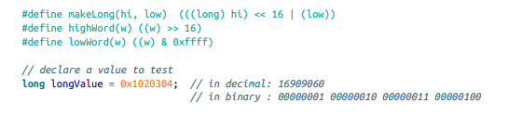
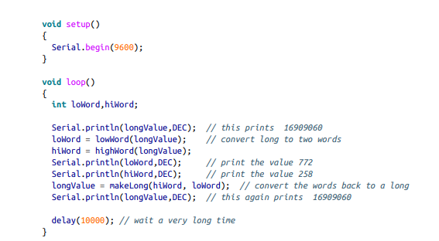
Example

Slide 26


